Slide 1
Building Websites Using ASP.NET Core Razor Pages

Slide 2
Objectives
Overview ASP.NET Core Razor Pages
Introduce Razor Page files and Razor syntax
Work with Page Models (Handler Methods, ViewData, Action Results)
Understand Tag Helpers in Razor Pages
Understand and work with View Components
Apply Routing and URLs in Razor Pages
Apply and configure the Startup with Razor Pages
Validate input data with Validation and Model Binding in Razor Pages
Understand and work with State Management in Razor Pages
Scaffolding for Razor Pages
Demo

Slide 3
ASP.NET Core Razor Pages - 1
ASP.NET Razor Pages is a server-side, page-focused framework that enables building dynamic, data-driven web sites with clean separation of concerns.
Part of the ASP.NET Core web development framework from Microsoft, Razor Pages supports cross platform development and can be deployed to Windows, Unix and Mac operating systems.
The Razor Pages framework is lightweight and very flexible.
It provides the developer with full control over rendered HTML.
Razor Pages is the recommended framework for cross-platform server-side HTML generation.

Slide 4
ASP.NET Core Razor Pages - 2
Razor Pages makes use of the popular C# programming language for server-side programming, and the easy-to-learn Razor templating syntax for embedding C# in HTML mark-up to generate content for browsers dynamically.
Architecturally, Razor Pages is an implementation of the MVC pattern and encourages separation of concerns.
Razor Pages is included within .NET Core from version 2.0 onwards, which is available as a free download as either an SDK or a Runtime.

Slide 5
Razor Pages
Razor is a markup syntax for embedding server-based code into webpages.
The Razor syntax consists of Razor markup, C#, and HTML. Files containing Razor generally have a .cshtml file extension.
The default Razor language is HTML. Rendering HTML from Razor markup is no different than rendering HTML from an HTML file. HTML markup in .cshtml
Razor files is rendered by the server unchanged.
Different types of ASP.NET Razor
Razor Page (Single Page Model) – Demo1.cshtml
Razor Page (with Page Model) – Demo2.cshtml + Demo2.cshtml.cs
Razor with MVC

Slide 6
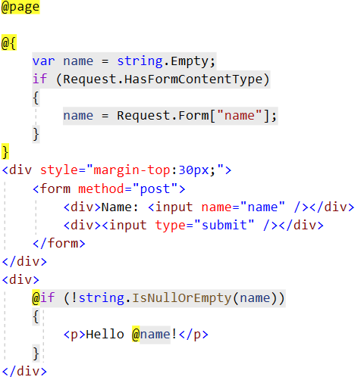
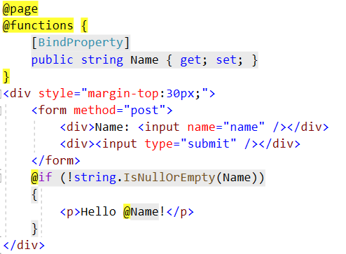
Razor Pages – Single File Approach
The Razor code block is denoted by an opening @{ and is terminated with a closing }. The content within the block is standard C# code.
Functions blocks

Slide 7
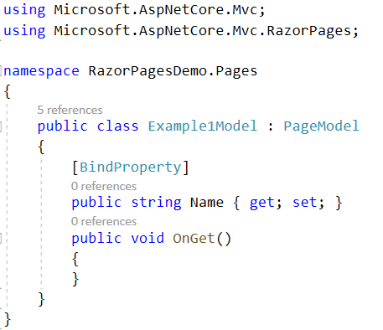
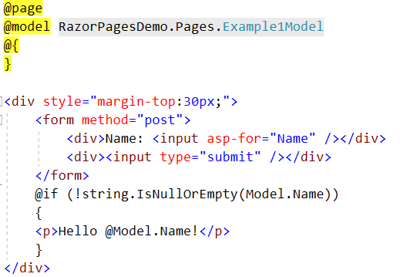
Razor Pages – PageModel Files
Any code relating to the processing of user input or data should be placed in PageModel files, which share a one-to-one mapping with their associated content page.
They even share the same file name, albeit with an additional .cs.

Slide 8
Different types of Razor files - 1
Razor files have a leading underscore (_) in their file name. These files are not intended to be browsable.
The _Layout.cshtml file acts a template for all content pages that reference it. Consistent part of a site's design are declared in this file.
The _ViewStart.cshtml file contains code that executes after the code in any content page in the same folder or any child folders. It provides a convenient location to specify the layout file for all content pages that are affected by it.
The _ViewImports.cshtml file provides a mechanism to make directives available to Razor pages globally so that you don't have to add them to pages individually.

Slide 9
Different types of Razor files - 2
Partial Pages or Views are Razor files containing snippets of HTML and server-side code to be included in any number of pages or layouts.
Partial pages can be used to break up complex pages into smaller units, thereby reducing the complexity and allowing teams to work on different units concurrently.
Partial pages are cshtml files that do not take part in routing. Rendering Partial Pages:
<partial name="_MenuPartial" />
@Html.Partial("_MenuPartial")
@{ Html.RenderPartial("_MenuPartial"); }

Slide 10
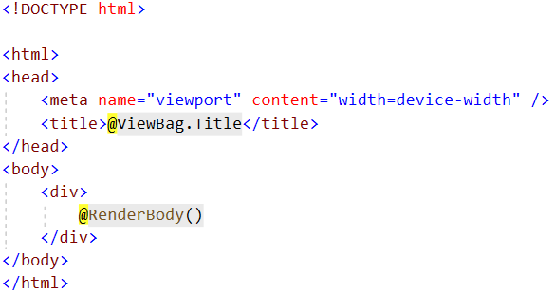
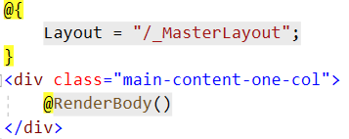
Different types of Razor files - 3
The layout page acts as a template for all pages that reference it.
_MasterLayout.cshtml
_SubLayout1.cshtml

Slide 11

Different types of Razor files - 4
_ViewImports.cshtml file provides a mechanism to centralize directives that apply to Razor pages.
The default Razor Pages template includes a _ViewImports.cshtml file in the Pages folder - the root folder for Razor pages.
The _ViewImports.cshtml file supports the following directives:
@addTagHelper, @removeTagHelper, @tagHelperPrefix
@inherits, @namespace
@inject, @model, @using

Slide 12
Razor Syntax
A Razor content page acts as a template for generating HTML. The typical content page includes static HTML, tag helpers that emit HTML dynamically, and C# code.
The C# code is embedded within the static content and tag helpers according to a set of rules, or syntax.
All code blocks must appear within @{ ... C# code } brackets.
Comments within a code block can be denoted by two forward slashes //. Alternatively, you can use /*...*/ or @*...*@.

Slide 13
The Razor Pages PageModel - 1
The main purpose of the Razor Pages PageModel class is to provide clear separation between the UI layer (the .cshtml view file) and processing logic for the page. There are a number of reasons why this separation is beneficial:
It reduces the complexity of the UI layer making it easier to maintain.
It facilitates automated unit testing.
It enables greater flexibility for teams in that one member can work on the view while another can work on the processing logic.
It encourages smaller, reusable units of code for specific purposes, which aids maintenance and scalability.

Slide 14
The Razor Pages PageModel - 2
The PageModel class is a combination of a Controller and a ViewModel.
Controllers feature in a number of design and architectural patterns concerned with the presentation layer of an application. They are most commonly found in the Model-View-Controller (MVC) pattern, where the controller can be implemented as a Front Controller or a Page Controller.
A front controller is defined as "a controller that handles all requests for a website". A page controller is "an object that handles a request for a specific page or action on a website". A Razor PageModel class is an implementation of the Page Controller pattern.
The Page Controller pattern is characterized by the fact that there is a one-to-one mapping between pages and their controllers.

Slide 15
The Razor Pages PageModel - 3
A View Model is an implementation of the Presentation Model design pattern.
It is a self-contained class that represents the data and behaviour of a specific "view" or page. The view model pattern is used extensively in MVC application development, where it mainly represents data, but typically little behaviour.
In Razor Pages, the PageModel is also the view model.
Razor Pages is sometimes described as implementing the MVVM (Model, View ViewModel) pattern. It doesn't. The MVVM pattern is applied to applications where the presentation and model share the same layer.

Slide 16
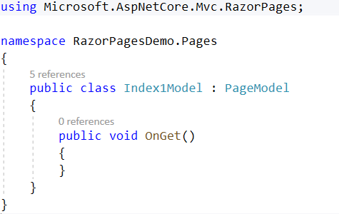

The Razor Pages PageModel - 4
The following code shows the content that is generated for each file when you use the Razor Page (with page model) option to add a new page to a Razor Pages application
Index1.cshtml.cs
Index1.cshtml

Slide 17
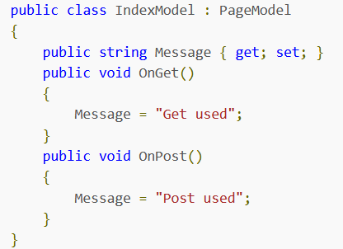
Handler Methods in Razor Pages - 1
Handler methods in Razor Pages are methods that are automatically executed as a result of a request. The Razor Pages framework uses a naming convention to select the appropriate handler method to execute.
The name of the method, which is prefixed with "On": OnGet(), OnPost(), OnPut() etc.
Handler methods also have optional asynchronous equivalents: OnPostAsync(), OnGetAsync() etc (methods that contain asynchronous code).
As far as the Razor Pages framework is concerned, OnGet and OnGetAsync are the same handler.

Slide 18
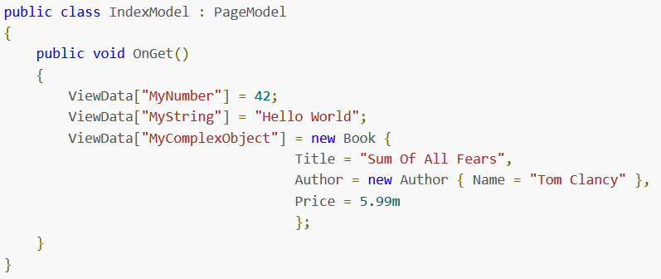
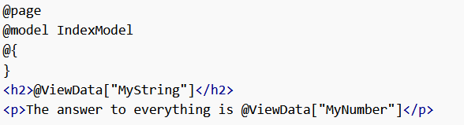
Working With ViewData in Razor Pages - 1
ViewData is a container for data to be passed from the PageModel to the content page.
ViewData is a dictionary of objects with a string-based key.

Slide 19
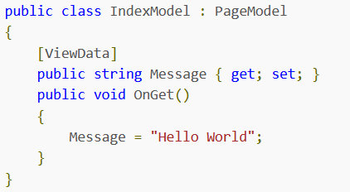
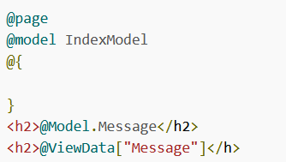
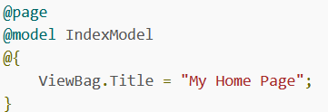


Working With ViewData in Razor Pages - 2
ViewData Attribute
ViewBag is a wrapper around the ViewData dictionary and provides an alternative way to access ViewData contents within ASP.NET Core MVC controllers using dynamic properties instead of string-based indexes.

Slide 20
Action Results in Razor Pages - 1
Action results in Razor Pages are commonly used as the return type of handler methods and are responsible for generating responses and appropriate status codes.
Action results implement either the abstract Microsoft.AspNetCore.Mvc.ActionResult class, or the Microsoft.AspNetCore.Mvc.IActionResult interface.

Slide 21
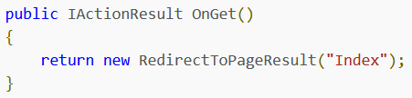
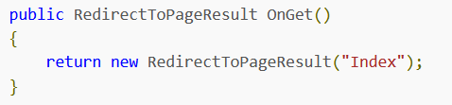
Action Results in Razor Pages - 2
ASP.NET Core includes more than three dozen ActionResult classes covering a wide range of needs, including but not limited to executing and returning the content of a Razor page, returning the content of a file, redirecting to another resource or simply returning a specific HTTP status code.

Slide 22
Tag Helpers - 1
Tag helpers are reusable components for automating the generation of HTML in Razor Pages.
Tag helpers target specific HTML tags. The ASP.NET Core framework includes a number of predefined tag helpers targeting many commonly used HTML elements as well as some custom tags:
Anchor tag helper, Cache tag helper, Environment tag helper,
Form Action tag helper, Form tag helper, Image tag helper,
Input tag helper, Label tag helper, Link tag helper, Option tag helper
Partial tag helper, Script tag helper, Select tag helper
Textarea tag helper, Validation tag helper, Validation Summary tag helper

Slide 23
Tag Helpers - 2
The Tag helpers used in Razor Pages were introduced as part of ASP.NET MVC Core and are found in the Microsoft.AspNetCore.Mvc.TagHelpers package which is included as part of the Microsoft.AspNetCore.All meta-package.
Enabling Tag Helpers
@addTagHelper *, Microsoft.AspNetCore.Mvc.TagHelpers
@addTagHelper "*, Microsoft.AspNetCore.Mvc.TagHelpers"
Selective tag processing - Use the @addTagHelper and @removeTagHelper directives to opt in or opt out of
@addTagHelper "*, Microsoft.AspNetCore.Mvc.TagHelpers"
@removeTagHelper "Microsoft.AspNetCore.Mvc.TagHelpers.AnchorTagHelper, Microsoft.AspNetCore.Mvc.TagHelpers"

Slide 24
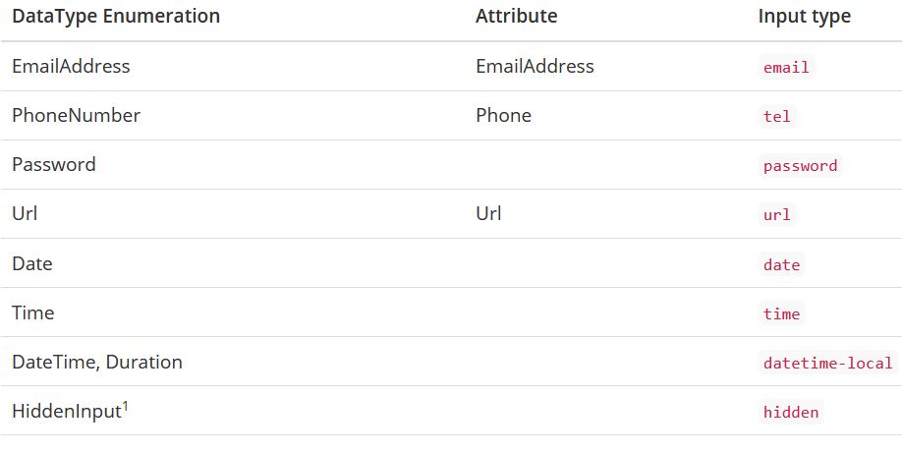
Tag Helpers - 3
The Input tag helper generates appropriate name and id attribute values based on the PageModel property that is assigned to it.
It will also generate an appropriate value for the type attribute, based on the property's meta data. The tag helper will also emit attributes that provide support for unobtrusive client-side validation.
Type attribute based on data annotations

Slide 25
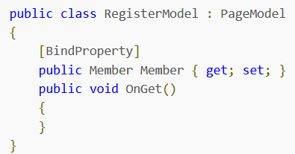
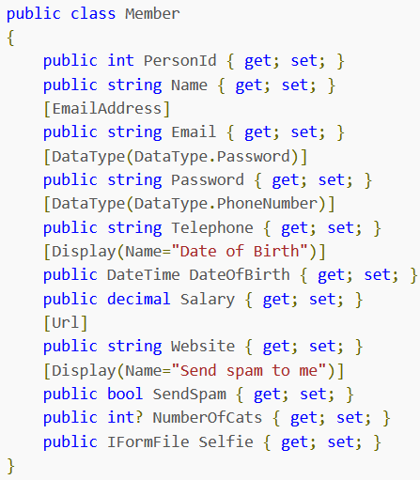
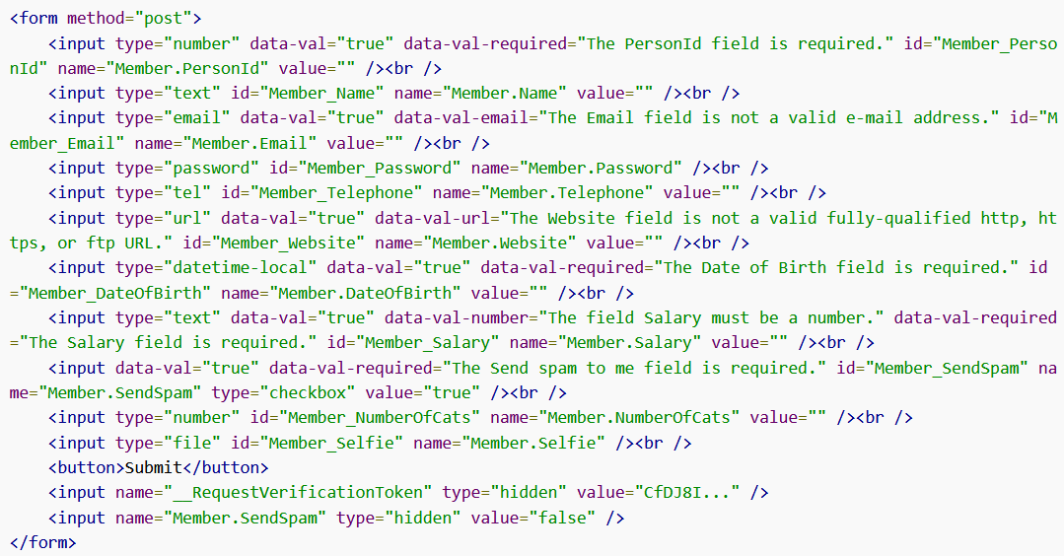
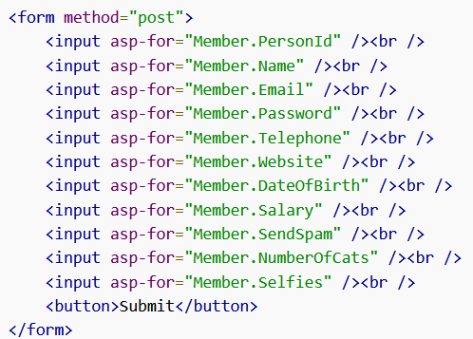
Tag Helpers - 4
2
1
Code generation
4
3

Slide 26
View Components in Razor Pages - 1
View Components perform a similar role to Tag Helpers and Partial Pages.
View components are recommended instead of partial pages or tag helpers whenever any form of logic is required to obtain data for inclusion in the resulting HTML snippet, specifically calls to an external resource such as a file, database or web service.
View components also lend themselves to unit testing.
View components are particularly useful for data-driven features in a layout page where there is no related page model or controller class.

Slide 27
View Components in Razor Pages - 2
View components consist of a class file and a .cshtml view file. The class file contains the logic for generating the model. It can be thought of as a mini-controller, just as the Razor PageModel file is considered to be a controller. The view file contains the template used to generate the HTML to be plugged in to the page that hosts the view component.
The class file must conform to the following rules:
It must derive from the ViewComponent class
It must have "ViewComponent" as a suffix to the class name or it must be decorated with the [ViewComponent] attribute
It must implement a method named Invoke with a return type of IViewComponentResult

Slide 28
Razor Pages Routing
Routing is the system that matches URLs to Razor pages (matching URLs to file paths, starting from the root Razor Pages folder)
When a Razor Pages application starts up, a collection of Attribute Routes is constructed, using the file and folder paths rooted in the Pages folder as the basis for each route's template.
Index.cshtml - you can access Index.cshtml by browsing to both http://yourdomain.com/ and http://yourdomain.com/Index.
If you create a folder named Demo and add a file named Index.cshtml to it, a further two routes will be defined with the following templates: "Demo", "Demo/Index"

Slide 29
The Startup Class - 1
ASP.NET Core makes extensive use of dependency injection (DI) - a technique that facilitates loose coupling of code. Components, or "services" are represented as abstractions, typically interfaces, as you have already seen in the Configure method with IApplicationBuilder.
The primary purpose of the ConfigureServices method is as a place to register implementation types for services that are needed by the application. It is also used to configure any options related to those services.
If it has been added to the Startup class, the ConfigureServices method is called before the Configure method. That makes sense, because the Configure method may attempt to reference services which need to be registered beforehand so that they can be resolved.

Slide 30
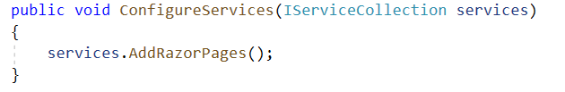
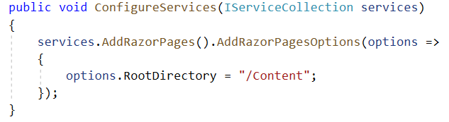
The Startup Class – 2
This is the case with the default template where Razor Pages is registered:
If you want to configure the root folder for Razor Pages to be something other than the default Pages, this is where you would do that

Slide 31
Configuration In Razor Pages - 1
ASP.NET Core includes an API for managing configuration settings needed by the application which includes a number of providers for retrieving data in a variety of different formats.
Configuration is set up as part of the WebHost.CreateDefaultBuilder method called in Program.cs, the entry point to the application. Various key/value stores are added to configuration by default
appsettings.json
User Secrets (if the environment is Development)
Environment variables
Command line arguments

Slide 32
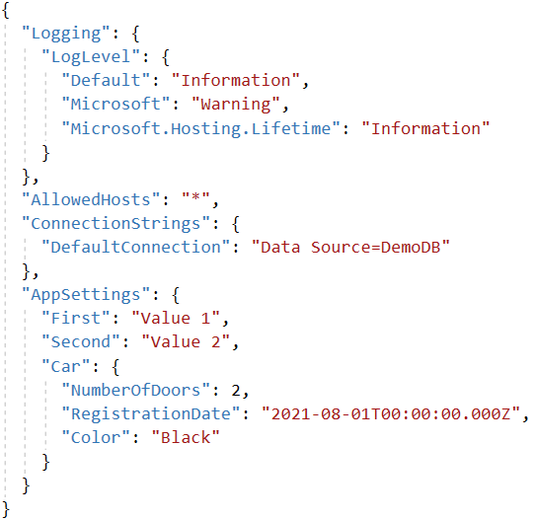
Configuration In Razor Pages - 2
The appsettings.json file includes a section that configures logging for the application.

Slide 33
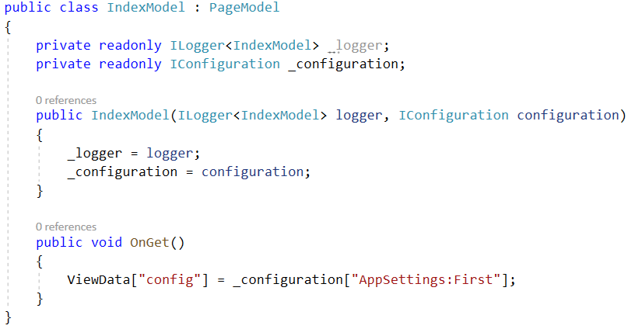
Configuration In Razor Pages - 3
The IConfiguration object enables you to access configuration settings in a variety of ways once it has been injected into your PageModel's constructor.
Add a using directive for Microsoft.Extensions.Configuration to the PageModel class file.
The Configuration class includes a convenience method for retrieving connection strings:
var conn = Configuration.GetConnectionString("DefaultConnection");

Slide 34
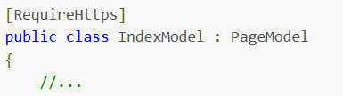
Configuration In Razor Pages - 4
Configuring your Razor Pages site to run under HTTPS
Running a site under HTTPS used to be something that only big online merchants worried about.
The RequireHttps attribute is an authorization filter whose role is to confirm that requests are received over HTTPS. If the request was not made over HTTPS, the client will be redirected to the HTTPS version of the request URI if the GET method was used. Non-HTTPS requests made using any other verb (e.g. POST) will receive a 403 Forbidden result.

Slide 35
Dependency Injection in Razor Pages
Dependency Injection (DI) is a technique that promotes loose coupling of software through separation of concerns.
In the context of a Razor Pages application, DI encourages you to develop discrete components for specific tasks, which are then injected into classes that need to use their functionality.
This results in an application that is easier to maintain and test.
Developers are advised to implement the SOLID principals of software design to ensure that their applications are robust and easier to maintain and extend. Another important guiding principal for developers is Don't Repeat Yourself (DRY), which states that should aim to reduce code repetition wherever possible.

Slide 36
Using Forms in Razor Pages - 1
Forms are used for transferring data from the browser to the web server for further processing, such as saving it to a database, constructing an email, or simply subjecting the data to some kind of algorithm and then displaying the result.
The HTML <form> element is used to create a form on a web page. The form element has a number of attributes, the most commonly used of which are method and action. The method attribute determines the HTTP verb to use when the form is submitted.
By default, the GET verb is used and the form values are appended to the receiving page's URL as query string values. If the action attribute is omitted, the form will be submitted to the current URL i.e. the page that the form is in.

Slide 37
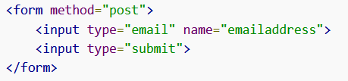
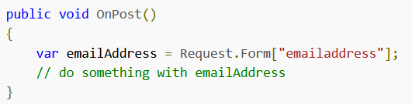
Using Forms in Razor Pages - 2
Access the user input. User input is only available to server-side code if the form control has a value applied to the name attribute. There are several ways to reference posted form values:
Accessing the Request.Form collection via a string-based index, using the name attribute of the form control as the index value.
Leveraging Model Binding to map form fields to handler method parameters.
Leveraging Model Binding to map form fields to public properties on a PageModel class.

Slide 38
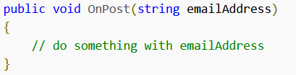
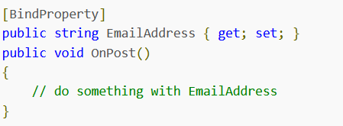
Using Forms in Razor Pages - 3
Leveraging Model Binding to map form fields to handler method parameters.
Leveraging Model Binding to map form fields to public properties on a PageModel class.

Slide 39
Validating User Input in Razor Pages – 1
Validate user input in two places in a web application: in the browser using client-side script or the browser's in-built data type validation; and on the server.
The MVC framework, on which Razor Pages is built, includes a robust validation framework that works against inbound model properties on the client-side and on the server.
The key players in the input validation framework are:
DataAnnotation Attributes, Tag Helpers
jQuery Unobtrusive Validation
ModelState
Route Constraints

Slide 40
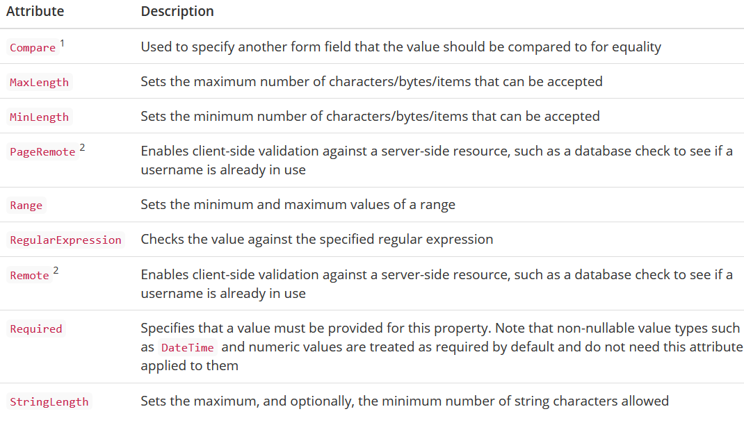
Validating User Input in Razor Pages – 2
The primary building block of the validation framework is a set of attributes that inherit from ValidationAttribute.
Most of these attributes reside in the System.ComponentModel.DataAnnotations namespace.

Slide 41
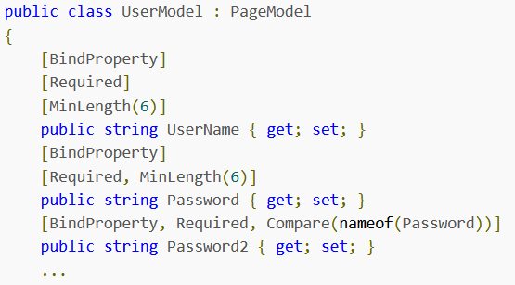
Validating User Input in Razor Pages – 3
An example of DataAnnotation attributes

Slide 42

Validating User Input in Razor Pages – 4
Client-side validation support is provided by the jQuery Unobtrusive Validation library, developed by Microsoft.
Must include jQuery Unobtrusive Validation within the page containing the form for client side validation to work. This is most easily accomplished by the inclusion of the _ValidationScriptsPartial.cshtml file (located in the Shared folder) within the page

Slide 43
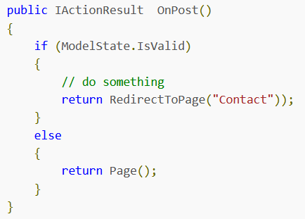
Validating User Input in Razor Pages – 5
Because it is so easy to circumvent client-side validation, server-side validation is included as part of the ASP.NET Core validation framework.
Once property values have been bound, the framework looks for all validation attributes on those properties and executes them.
Any failures result in an entry being added to a ModelStateDictionary. This is made available in the PageModel class via ModelState, which has a property named IsValid that returns false if any of the validation tests fail.

Slide 44
Model Binding - 1
Model Binding in Razor Pages is the process that takes values from HTTP requests and maps them to handler method parameters or PageModel properties.
Model binding reduces the need for the developer to manually extract values from the request and then assign them, one by one, to variables or properties for later processing.
This work is repetitive, tedious and error prone, mainly because request values are usually only exposed via string-based indexes.
Model binding approaches:
Binding posted form values to Handler Method parameters
Binding posted form values to PageModel properties

Slide 45
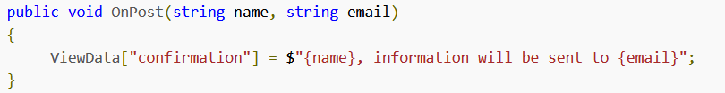
Model Binding - 2
Binding posted form values to Handler Method parameters
The parameters are named after the form fields, and given an appropriate type for the expected data. To see this approach in action, remove the assignment code in the OnPost handler method and add two parameters to the method
When the form is posted, the Razor Pages framework calls the OnPost method and sees that it has two parameters.

Slide 46
Model Binding - 3
Binding posted form values to PageModel properties
This approach is more suitable if you need to access the values outside of the handler method (for display on the page or binding to tag helpers), or if you prefer to work in a strongly typed manner within the Razor content page.
This approach involves adding public properties to the PageModel (or to a @functions block if you don't want to use the PageModel approach) and then decorating them with the BindProperty attribute.

Slide 47
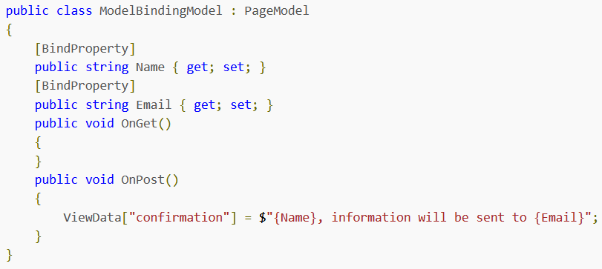
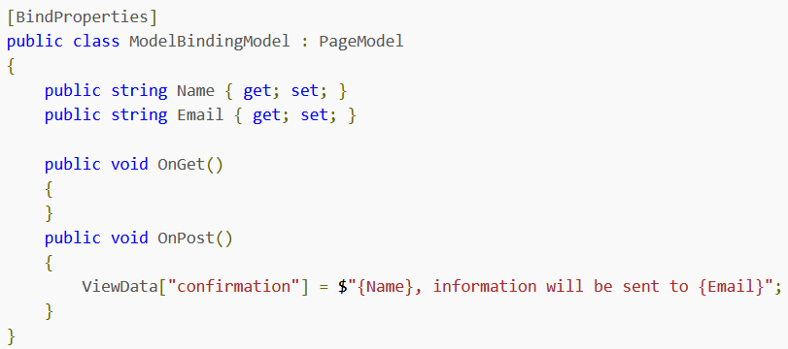
Model Binding - 4
Binding posted form values to PageModel properties (contd.)

Slide 48
State Management in Razor Pages - 1
Managing state in Razor Pages is the process of retaining user or application-related data over the duration of a number of requests.
Razor Pages, along with its underlying MVC framework provides a number of mechanisms for retaining information (or state) across requests, each with its benefits and drawbacks:
Hidden Form Fields
Query Strings
Route Data
Cookies
TempData, Session Variables, Application Variables, Caching

Slide 49
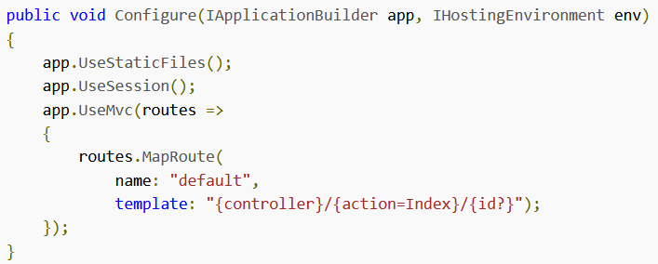
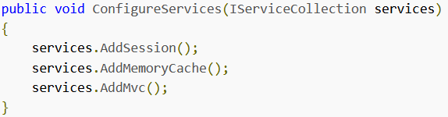
State Management in Razor Pages - 2
Session state is a mechanism that enables you to store and retrieve user specific values temporarily. These values can be stored for the duration of the visitor's session on your site.
Session management in ASP.NET Core is included in the Microsoft.AspNetCore.All metapackage, but is not enabled by default. Must enable Session State in the Startup file.

Slide 50

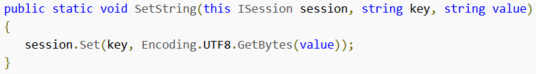
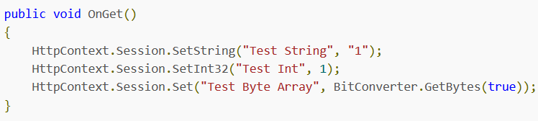
State Management in Razor Pages - 3
Configuring Sessions
Using Session Variables

Slide 51
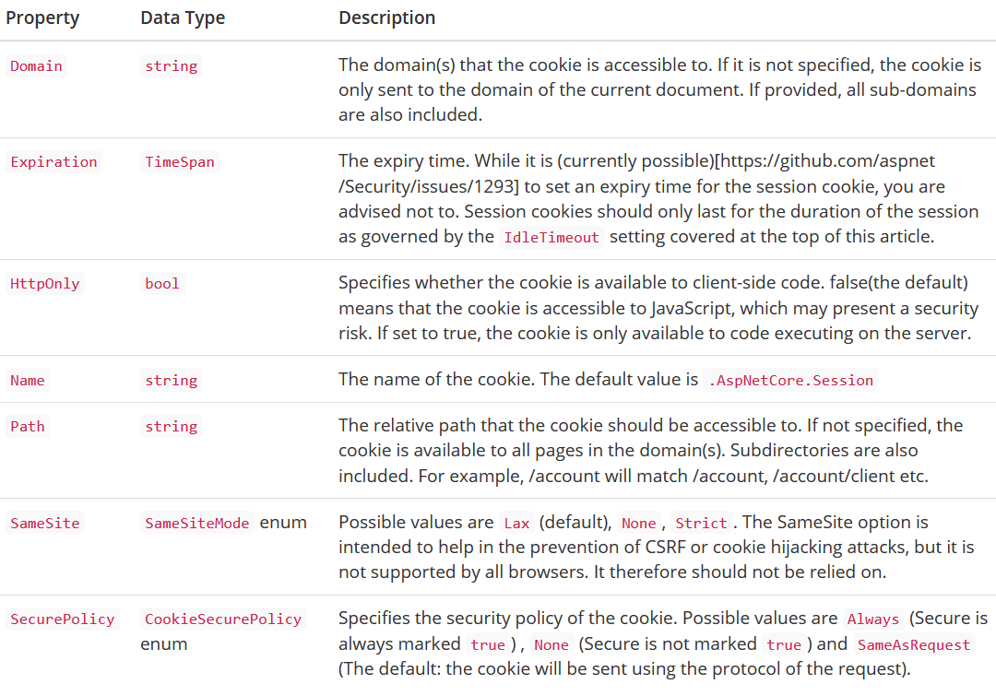
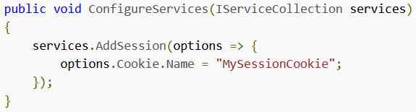
State Management in Razor Pages - 4
ASP.NET Core uses cookies to tie multiple request together in a session.
List of properties of Cookie

Slide 52

Working with AJAX in Razor Pages - 1
AJAX is a technique used for making requests from the browser to the server for various purposes such as the retrieval of assorted content including data, HTML, XML, posting form values and so on.
Requests are initiated from client script (usually JavaScript) once the page has already been loaded in the browser.
If you wanted to update parts of the page as a result of choices that the user made, those choices would have to be sent to the server as a form post and the page would be regenerated on the web server in its entirety.
The use of AJAX in a web page eliminates this stop-start approach to working in a web page.

Slide 53
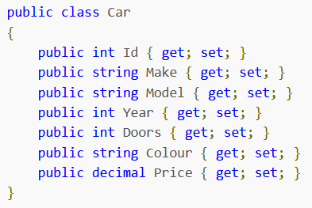
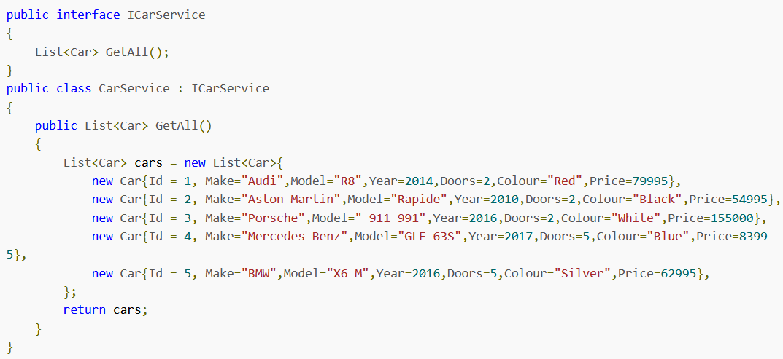
Working with AJAX in Razor Pages - 2
1
2

Slide 54
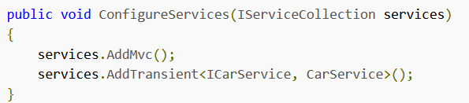
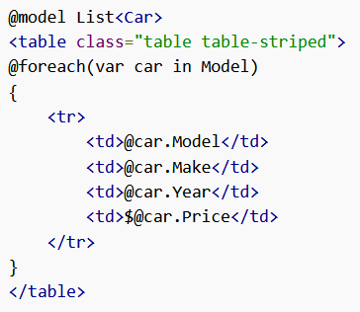
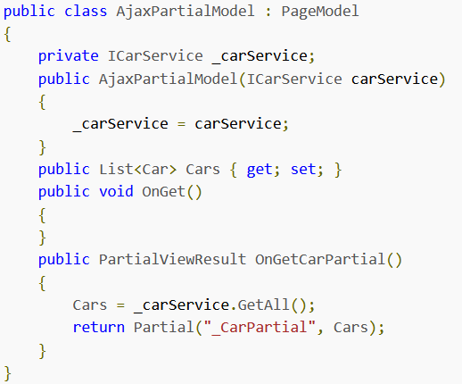
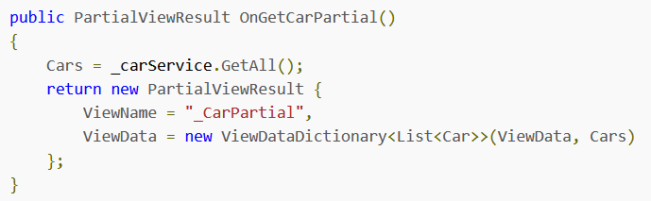
Working with AJAX in Razor Pages - 3
3
4
5
6

Slide 55
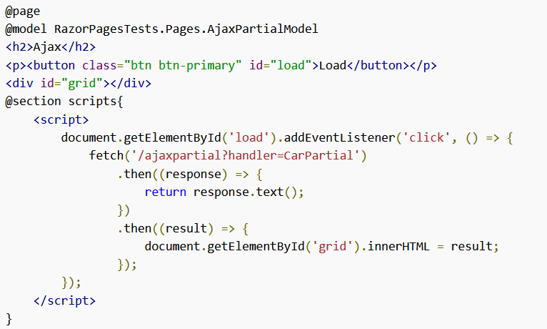
Working with AJAX in Razor Pages - 3
7

Slide 56
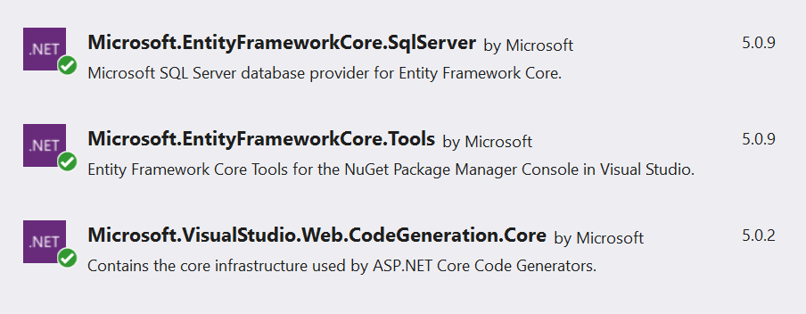
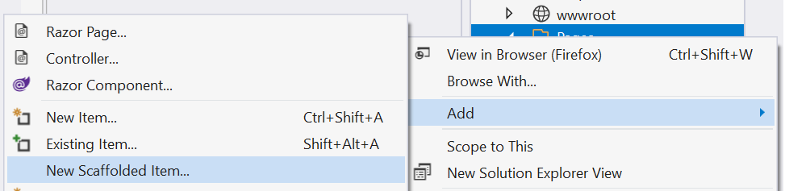
Scaffolding Razor Pages
Scaffolding in ASP.NET Core is a technique used to generate code at design time to support a number of common application scenarios when working with Entity Framework Core.
The code generation tool is available as a Nuget package.

Slide 57
Razor Pages Demo

Slide 58

Demo 1.
Step 01. Create ASP.NET Core Web App
Step 02. Using Model Binding in Razor Pages to takes values from HTTP requests and maps them to handler method parameters or PageModel properties.
Step 03. Create custom validation class
Step 04. Create a Model using DataAnnotations and custom validation.
Step 05. Create Razor Page (Empty) for form validation
Step 06. Create Razor Page (Empty) for uploading files
Step 07. Build and run Project.

Slide 59



Demo 1.
Step 01. Create ASP.NET Core Web App (A project template for creating an ASP.NET application with example ASP.NET Razor Pages content.)

Slide 60


Demo 1.
Step 02. Using Model Binding in Razor Pages to takes values from HTTP requests and maps them to handler method parameters or PageModel properties.

Slide 61

Demo 1.
Step 03. Create custom validation class

Slide 62

Demo 1.
Step 04. Create a Model using DataAnnotations and custom validation.

Slide 63




Demo 1.
Step 05. Create Razor Page (Empty)

Slide 64

Demo 1.
Step 05. (contd.)

Slide 65



Demo 1.
Step 06. Create Razor Page (Empty) for uploading files

Slide 66


Demo 1.

Slide 67

Demo 2. Razor Pages with Entity Framework
Step 01. Create ASP.NET Core Web Application
Step 02. Add model – Student, Course, Enrolment.
Step 03. Manage NuGet packages for Solution/Project
Step 04. Add Connection string (appsettings.json file)
Step 05. Scaffold Student pages
Step 06. Change the code on Startup.cs and Program.cs
Step 07. Build and run Program.

Slide 68

Demo 2. Razor Pages with Entity Framework
Manage NuGet packages for Solution/Project

Slide 69

Demo 2. Razor Pages with Entity Framework
The scaffolding process will provide these files (creates Razor pages in the Pages/Students folder)

Slide 70

Demo 3
Razor Pages with Entity Framework CRUD (includes search, sorting and paging)

Slide 71
Summary
Concepts were introduced:
Razor Page files and Razor syntax
Page Models (Handler Methods, ViewData, Action Results)
Tag Helpers
View Components
Routing and URLs
Startup with Razor Pages and Configuration
Validation and Model Binding
State Management
Scaffolding

